Slide 1
POCKET NUTRITIONIST
BETTER FOOD, INSTANTLY

Slide 2
Inspiration and Intent
For 25 years, more than half the adult population of the United States has been overweight or obese*
Healthy eating patterns are achievable by eating fresh, whole foods, but many of our healthiest options don’t have labels that give nutritional information
This app was created to provide that information, for myself and for the millions of Americans looking to live healther lives
*Source: USDA 2015-2020 Guidelines for Americans:
https://health.gov/sites/default/files/2019-09/2015-2020_Dietary_Guidelines.pdf

Slide 3
DATA USED
In 2015, the USDA published the “USDA National Nutrient Database for Standard Reference, Release 28”
It contains over 9000 individual entries, and lists both macro and micronutrients
To present this data more clearly, I narrowed the number of categories down to 10, and only presented macronutrient information (Calories, Carbohydrates, Sugars, Proteins, Fats)

Slide 4
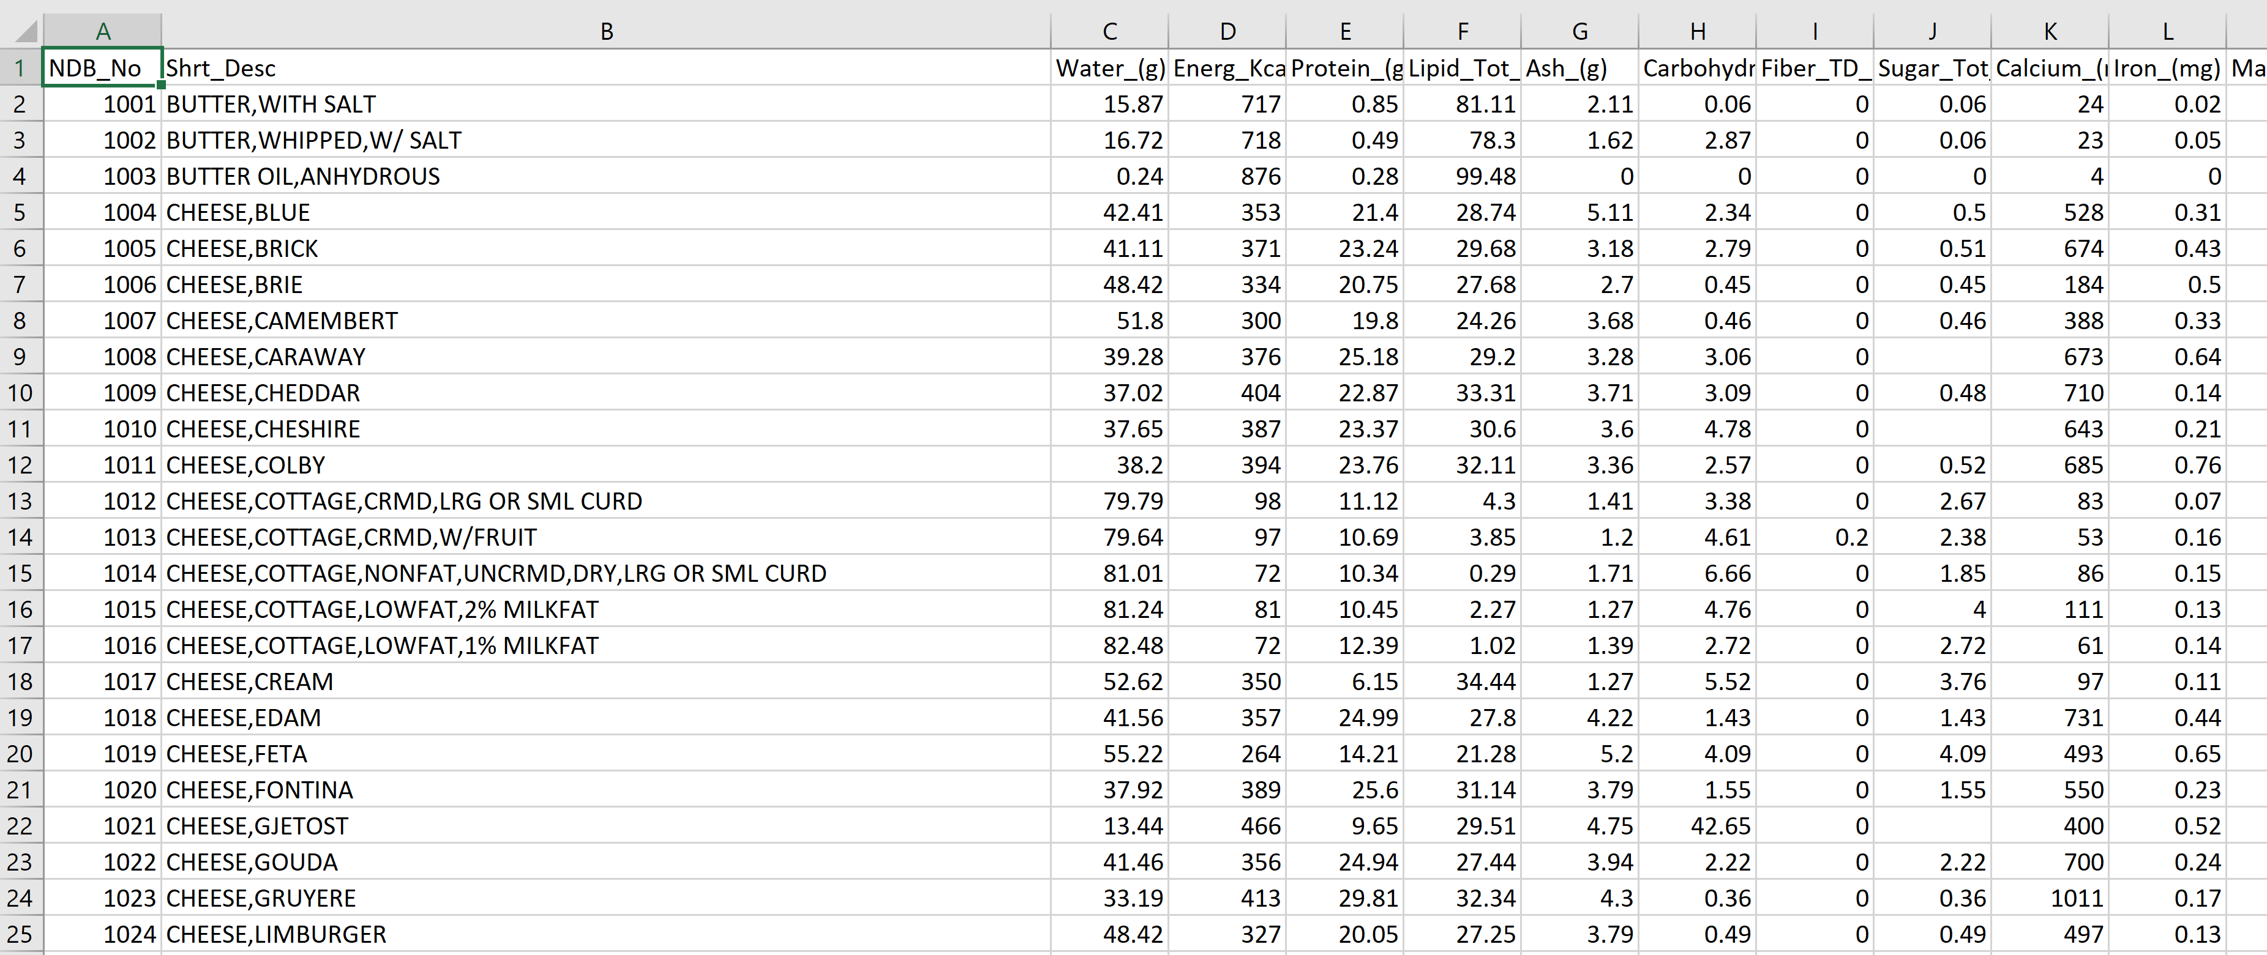
DATA USED

Slide 5
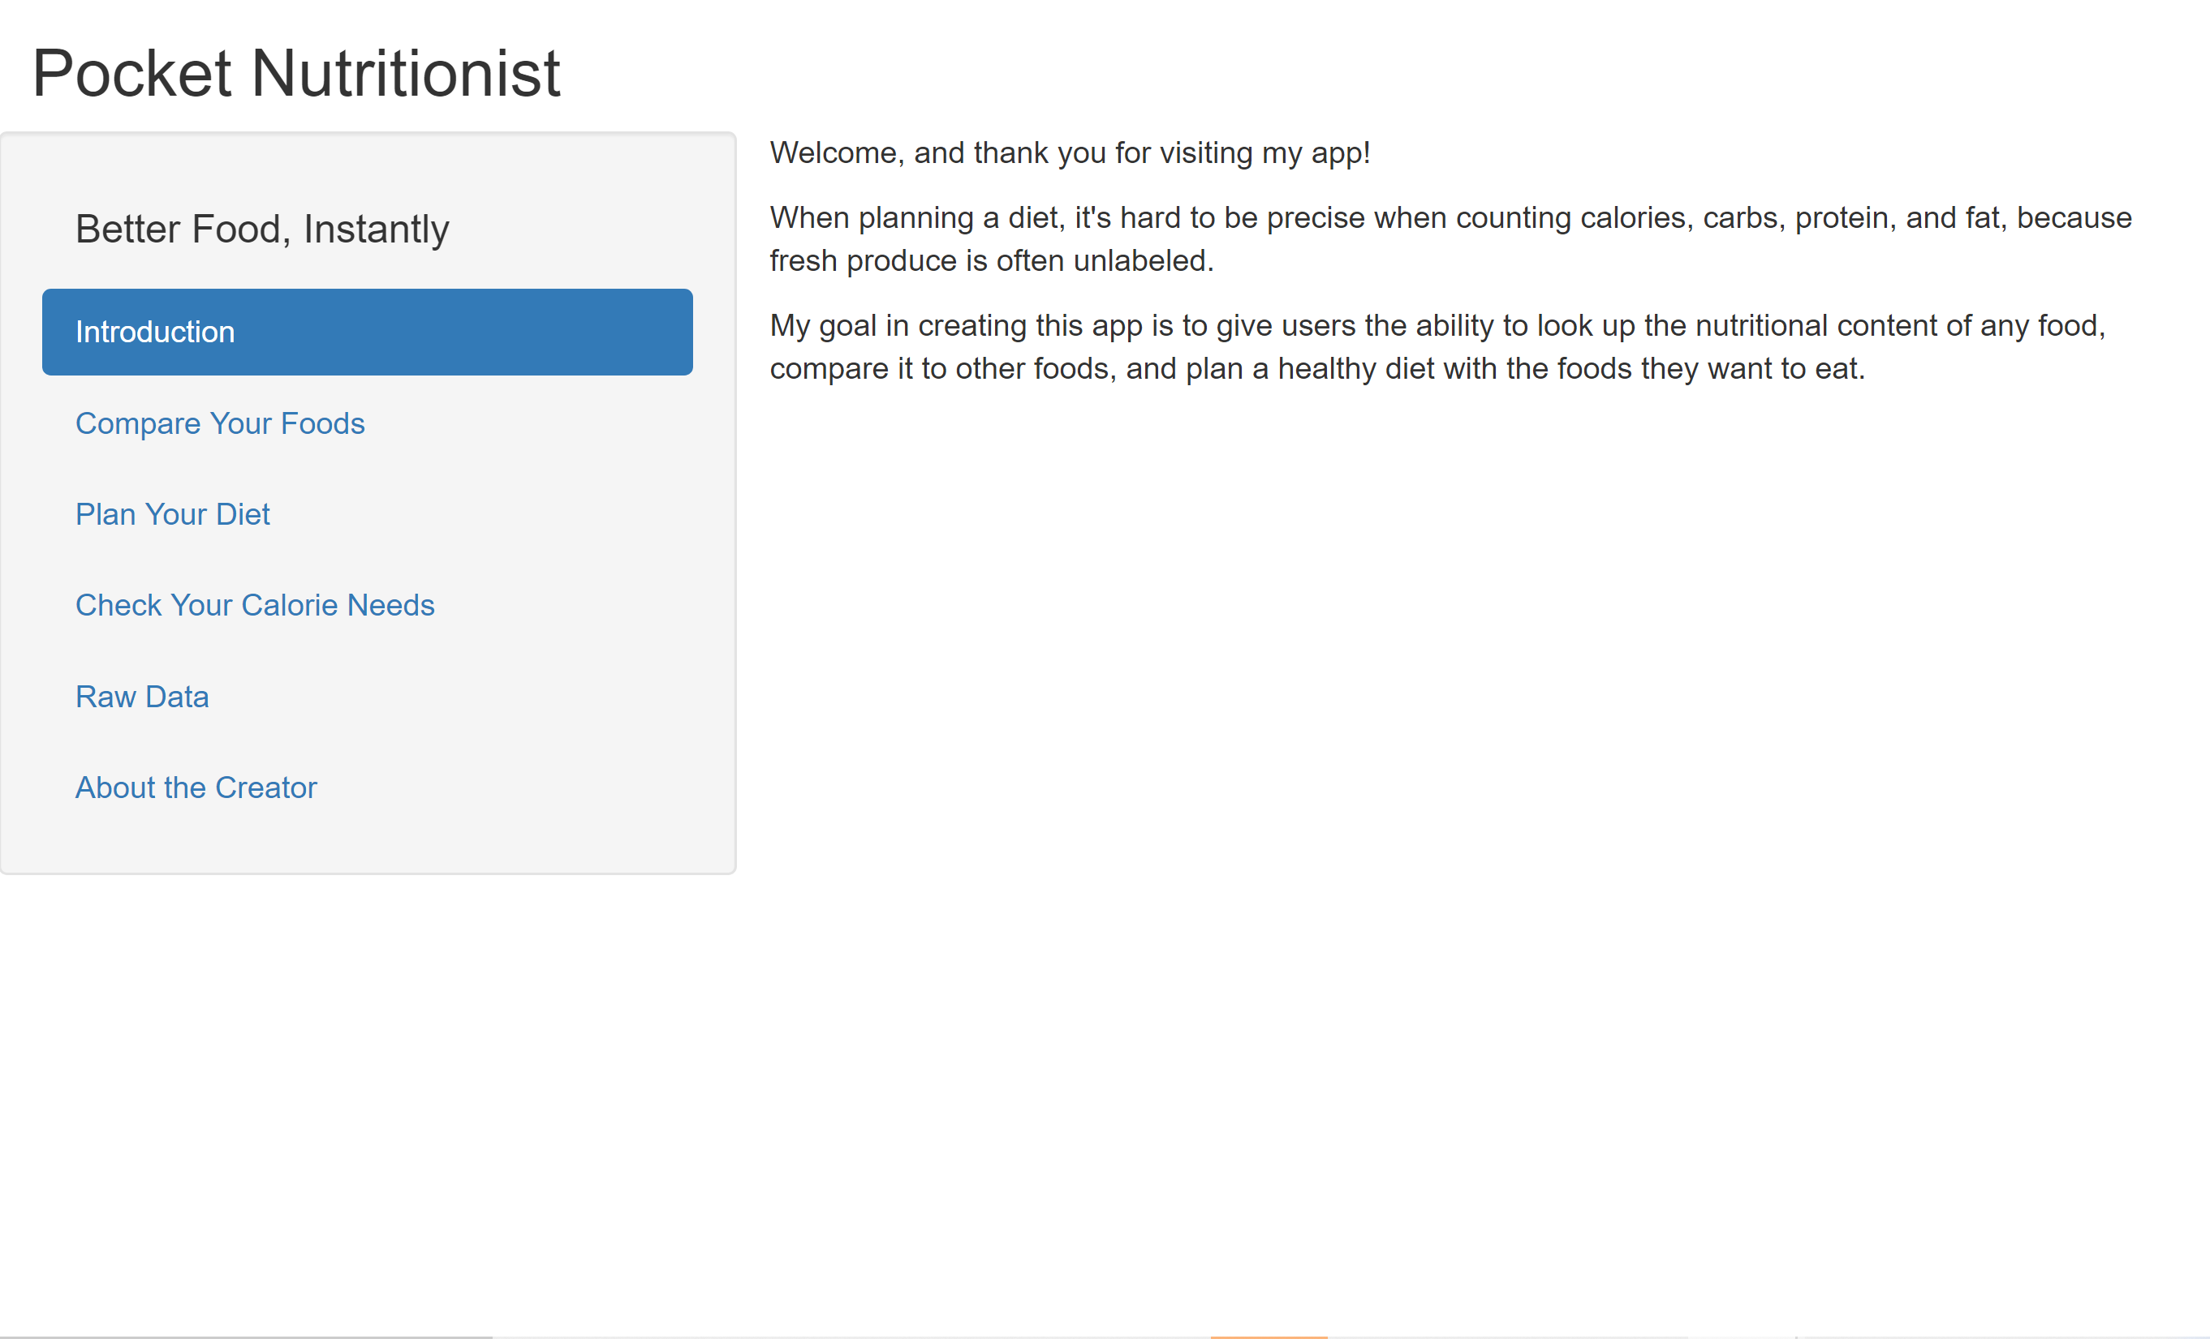
LAYOUT

Slide 6
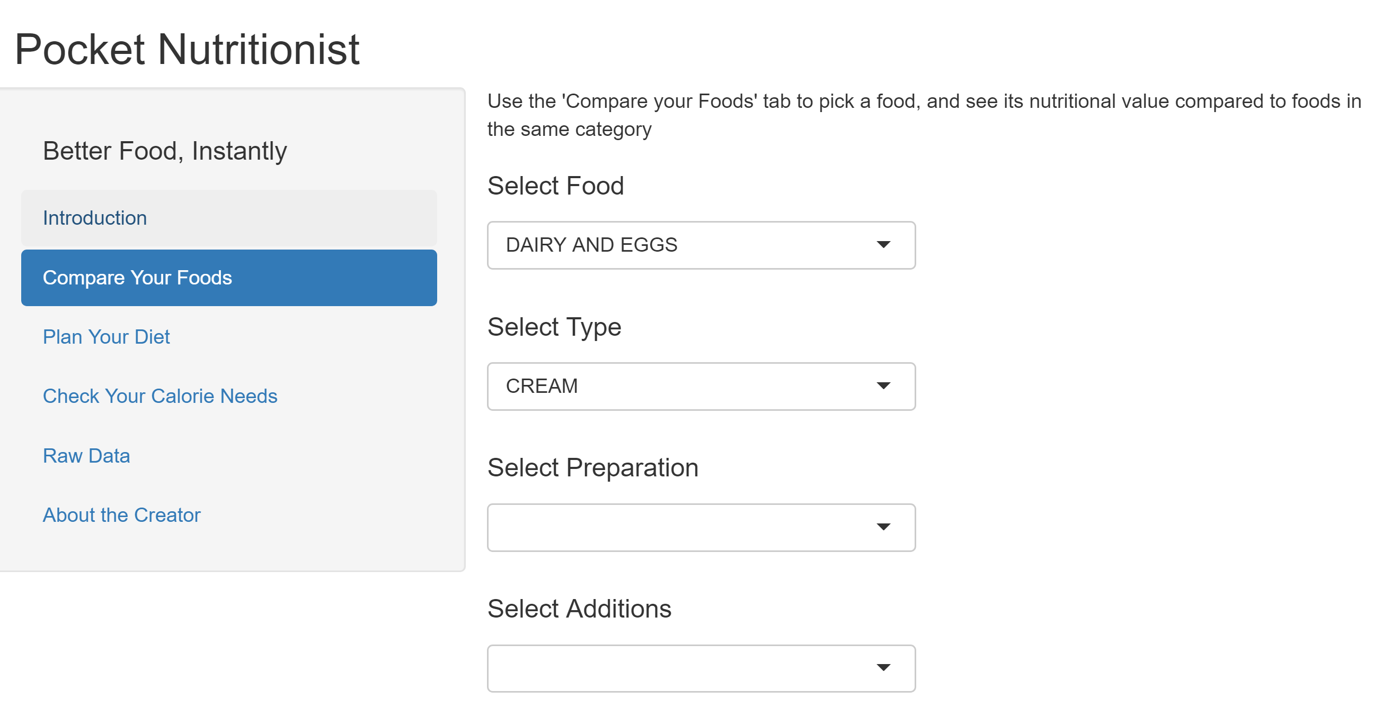
COMPARE YOUR FOODS

Slide 7
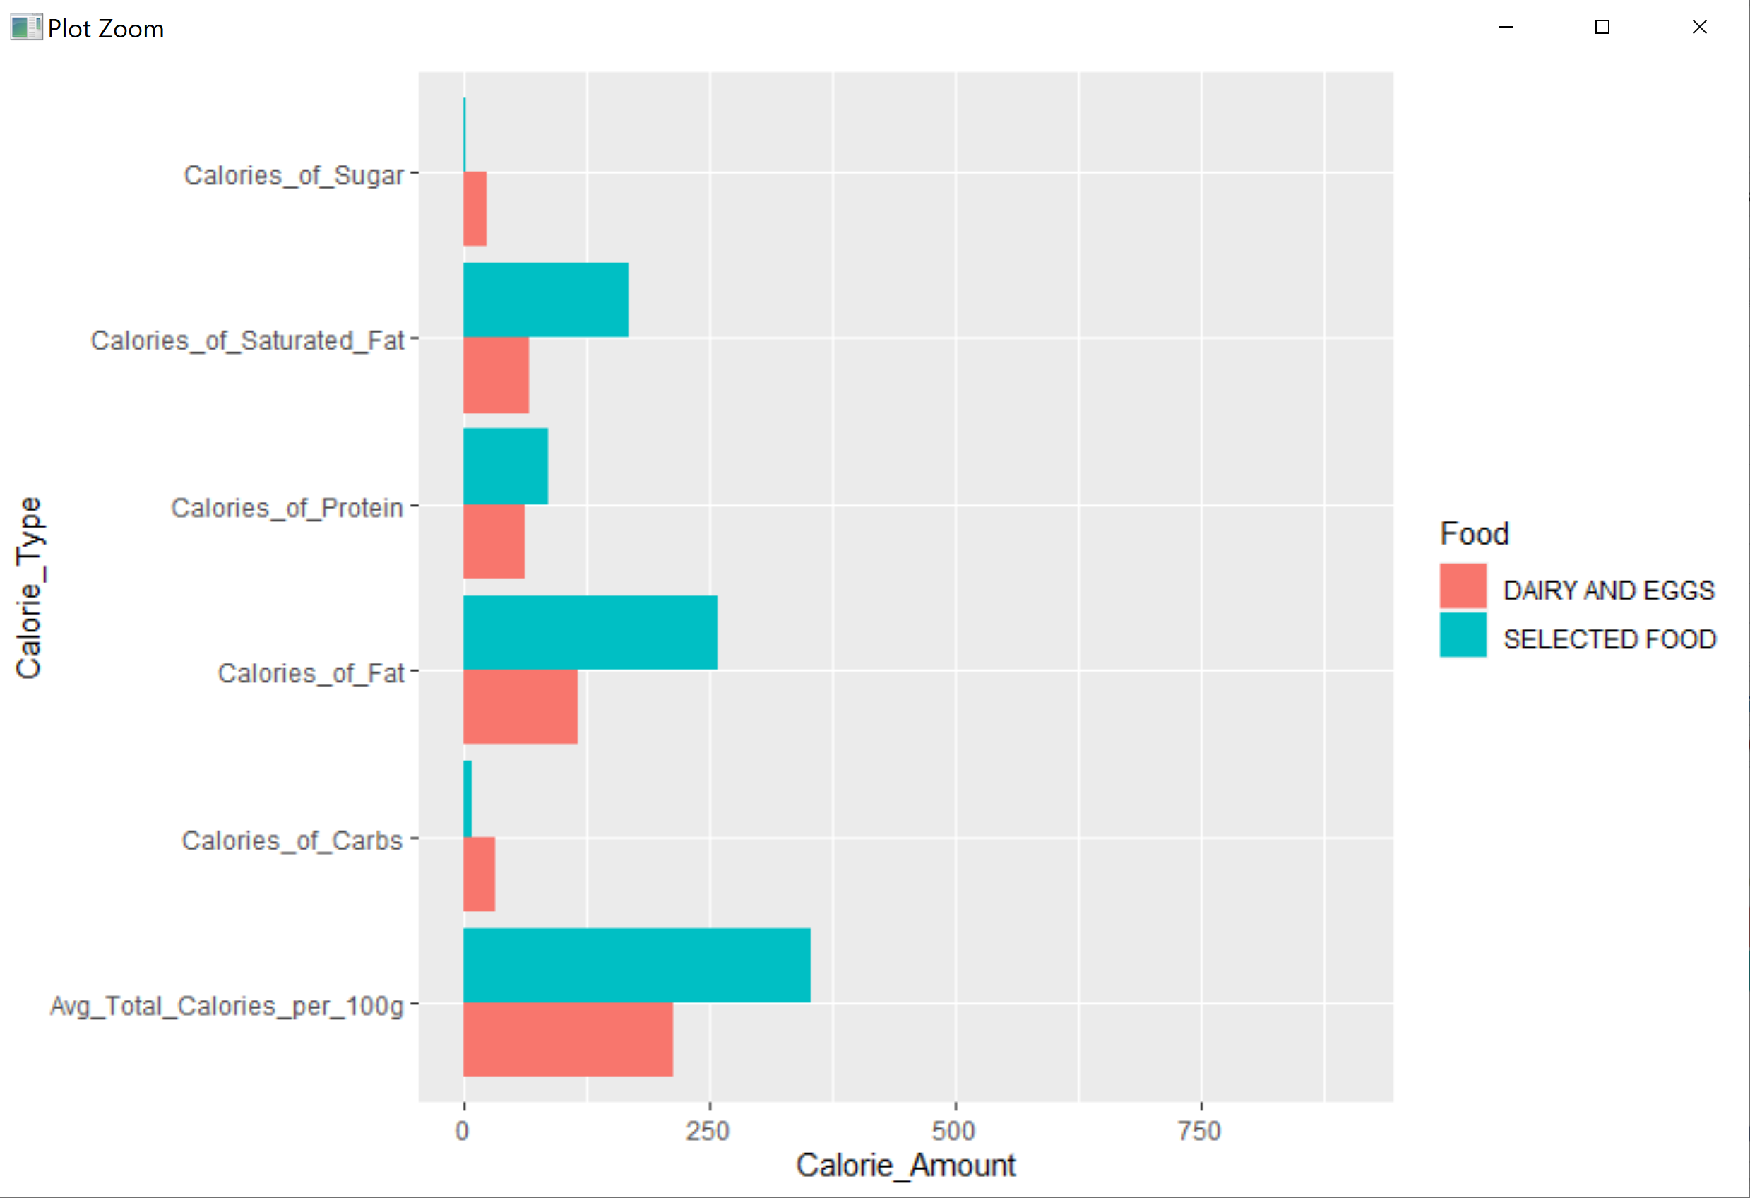
COMPARE YOUR FOODS

Slide 8
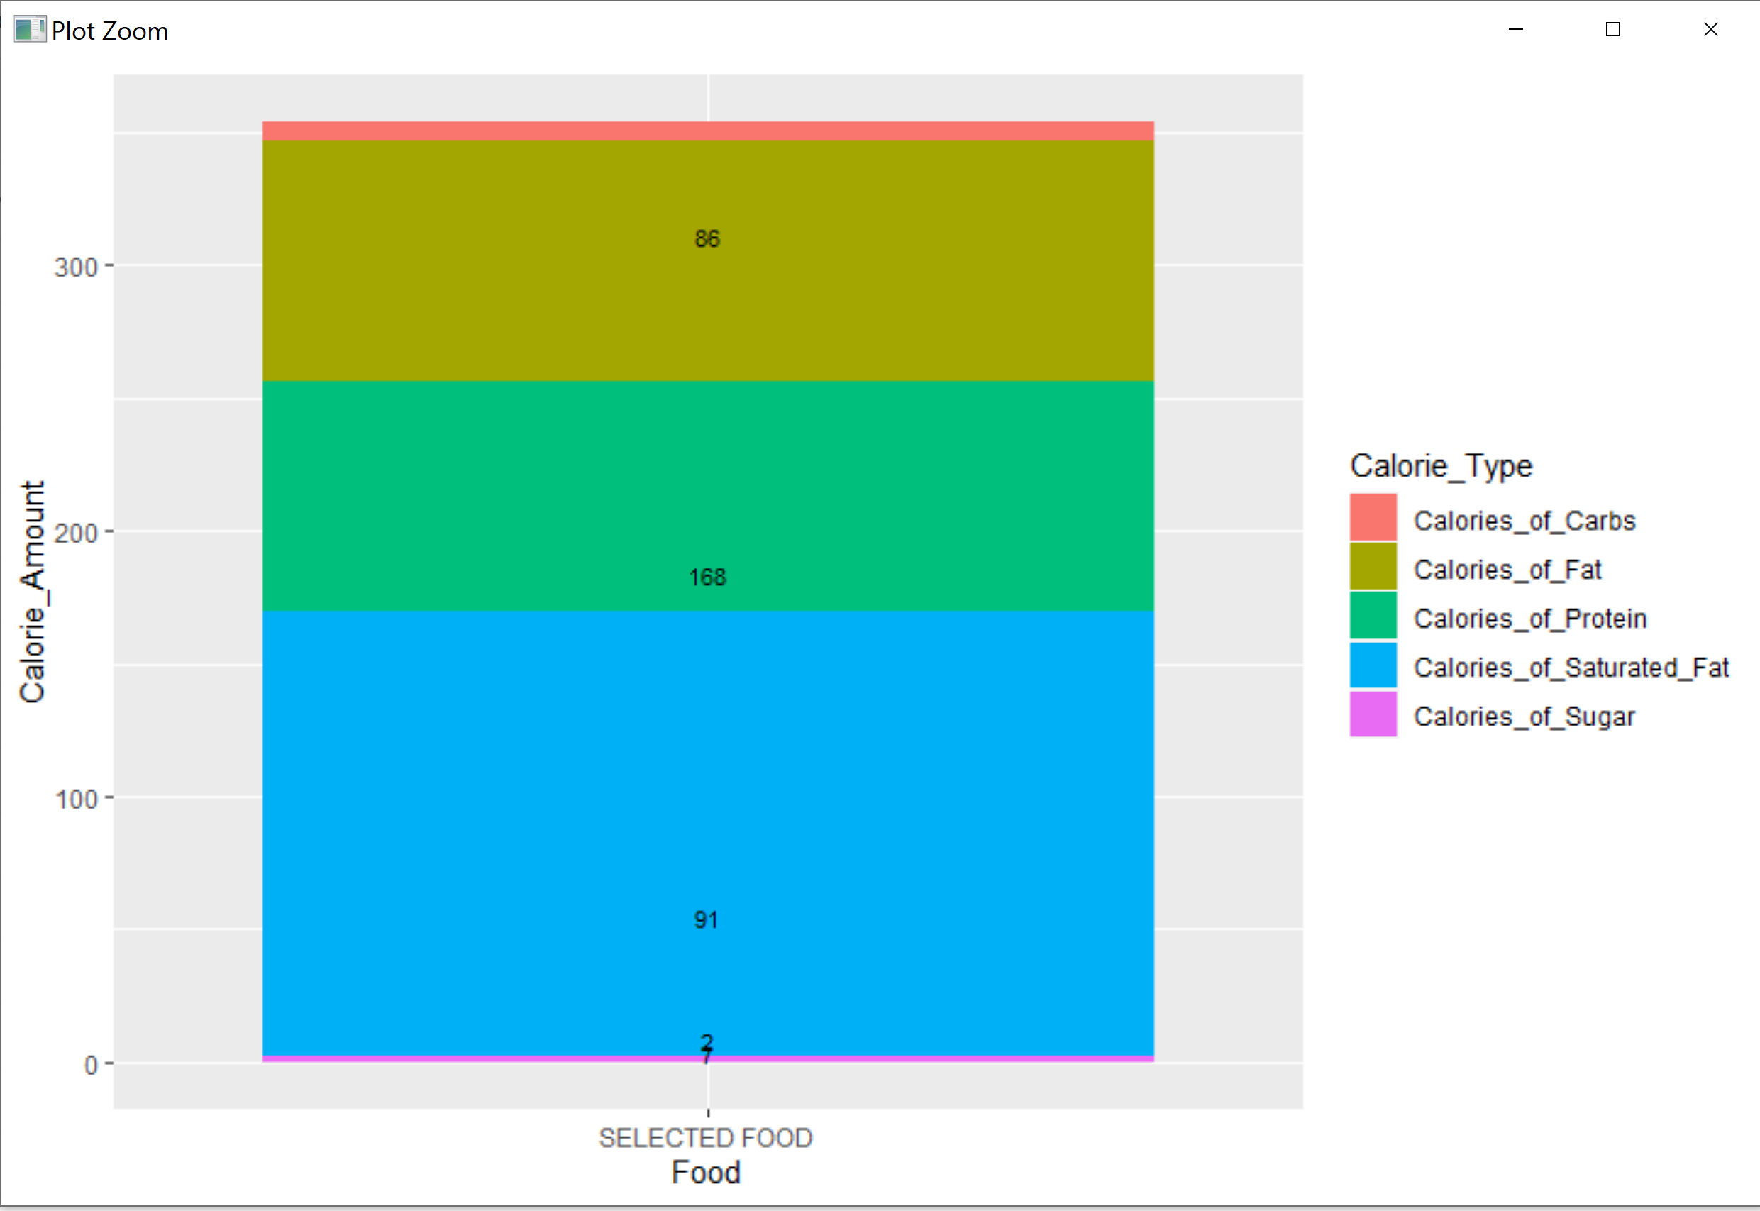
DIET PLANNER

Slide 9
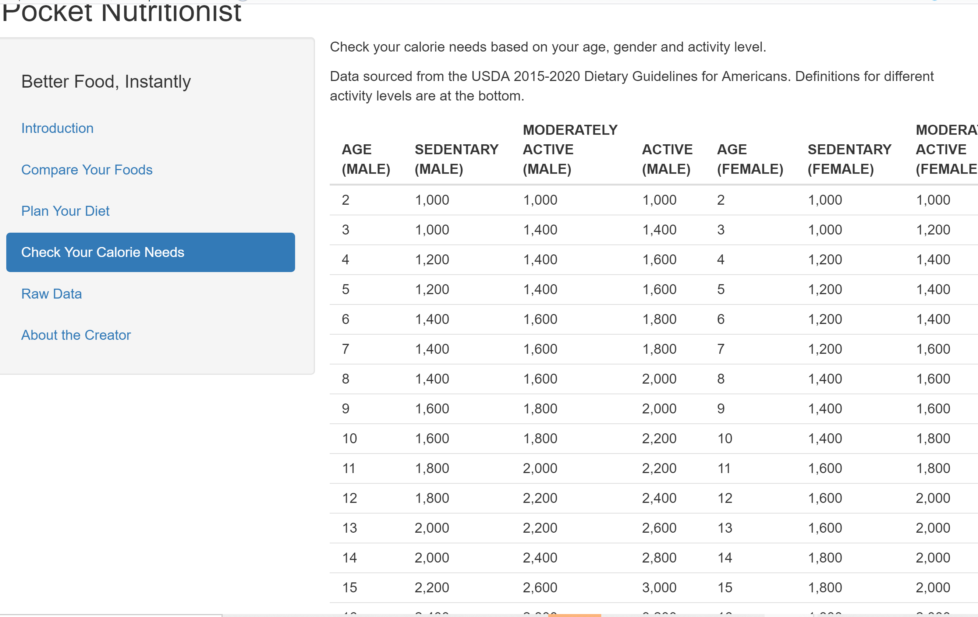
CALORIE NEEDS

Slide 10
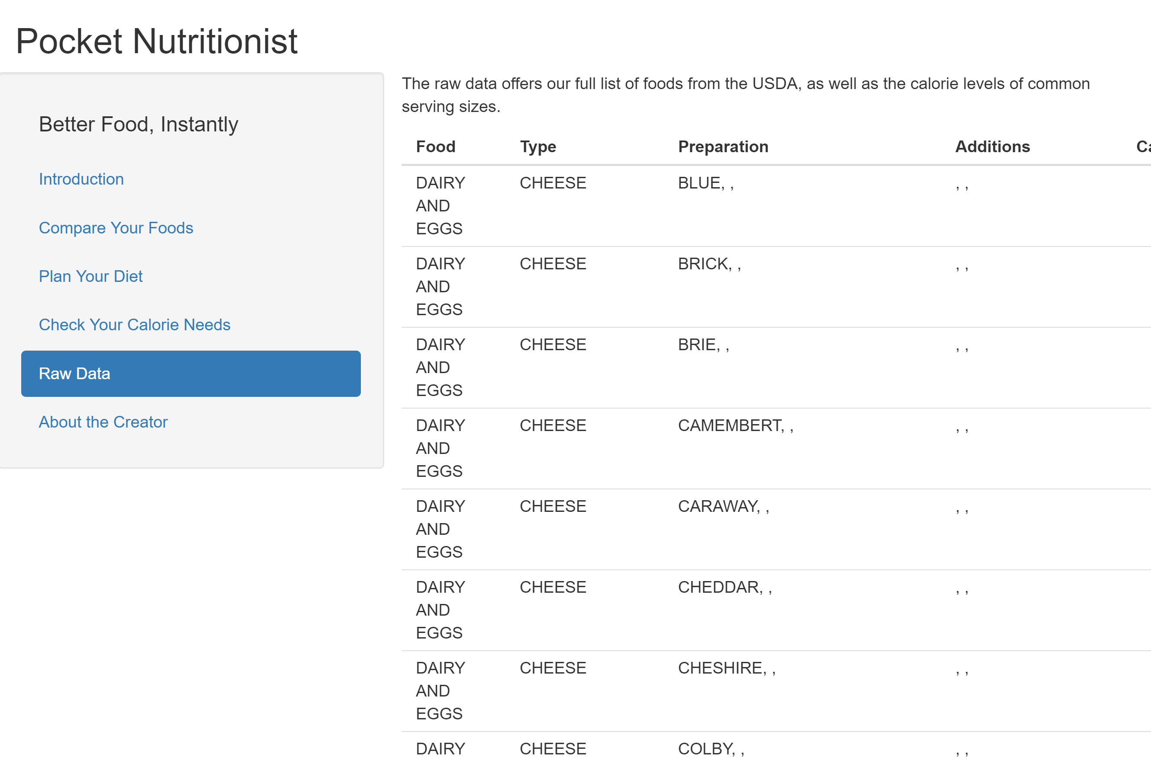
RAW DATA

Slide 11
FUTURE UPDATES
Diet planner graph to be a pie graph, with calorie percentages inside rather than a calorie total
Diet planner to include data list of calorie totals for items input
Diet planner to compare calorie totals to calorie needs, determined by direct input of age, gender, and activity level

Slide 12
APPLICATIONS
Standalone app, partnership with grocery stores and US Government to encourage healthier eating, produce buying at grocery stores
Partnership with health or fitness app, addition to portfolio to increase customer retention or new customer acquisition

Slide 13
THANK YOU!

